Slide 1


Some basics of AutoReject
Mainak Jas
MNE Workshop (NIH)
Joint work with:
Alexandre Gramfort, Denis Engemann et al.
May 28, 2019
Notes:
Thank jury. Thank president
Automating analysis of neural time series.
The PhD was advised by Alexandre Gramfort.
PhD cumulation of 3 years of research.
Different from Telecom research but similar methods.

Slide 2
Rejecting based on peak-to-peak amplitudes
Peak-to-peak amplitude A
A < threshold τ
Yes?
No?
Good data
Bad data
Notes:
Peak to peak = maximum – minimum amplitude
Types of artifacts: loose sensor, flux jumps
These artifacts can affect other algorithms downstream

Slide 3
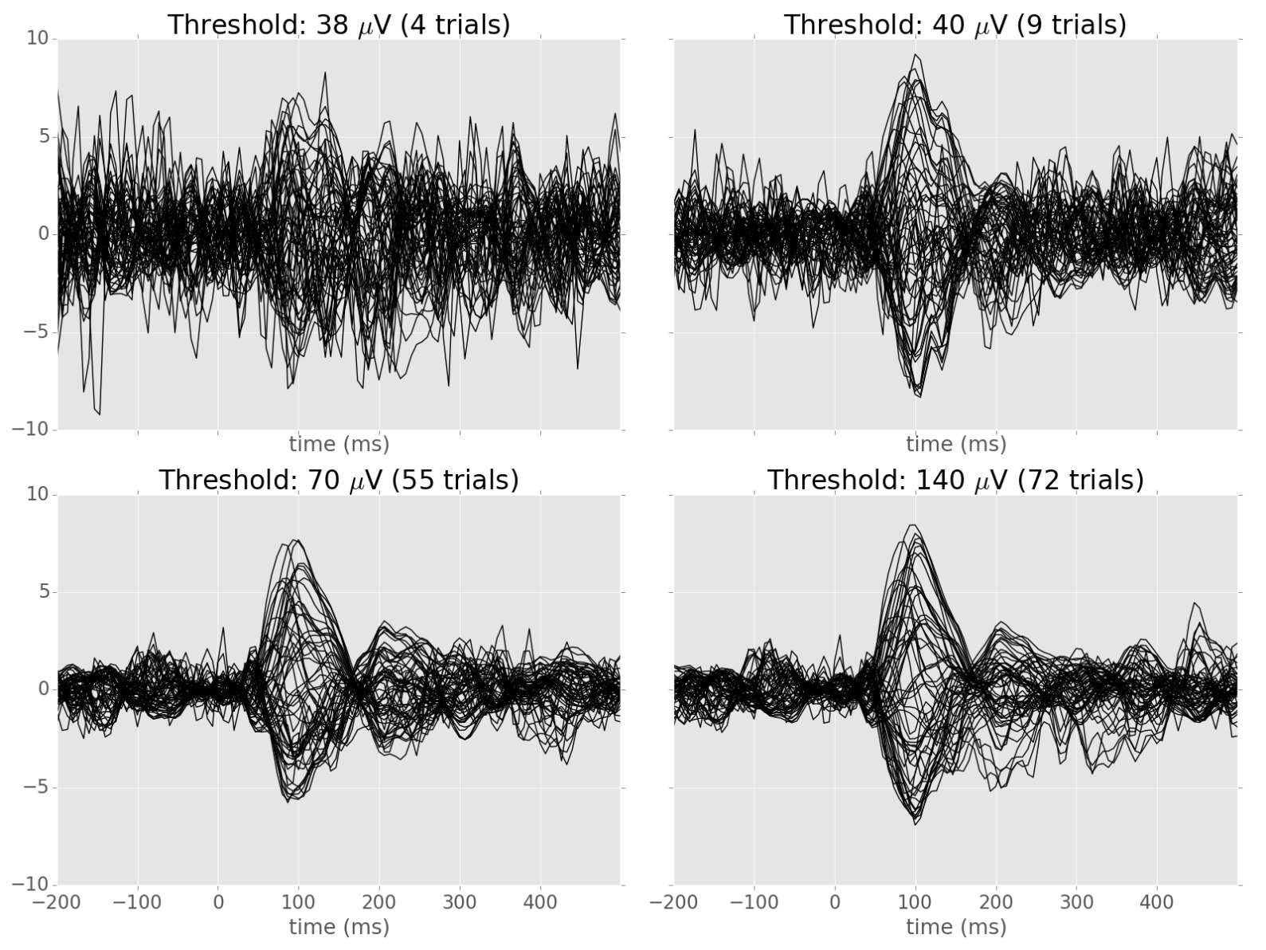
Observation: The optimal threshold retains sufficient trials while rejecting outliers.
Too few trials!
Outliers not removed
Optimal
Evoked
response
Notes:
Average for different sensors overlaid in one plot
Strategy: try low to high threshold, select best data quality

Slide 4
How do we measure data quality?
Many trials for a single sensor
Artifact
Training set
Validation set
RMSE =
(lower error = cleaner training set)
X_{train(τ)}
X_{val}
_{Fro}

Slide 5
But what if my validation data also has artifacts?
Validation set
X_{val}
~
X_{val}
Answer: use the median instead of the mean
~
RMSE=
X_{train(τ)}
X_{val}
_{Fro}

Slide 6
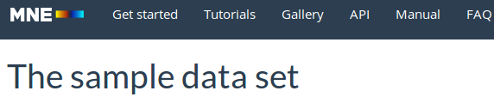
Autoreject (global) vs. human threshold
Remove trial if data in any sensor > τ
Average with 5-fold cross-validation

Slide 7
Each sensor has a different threshold
Sensors
Trials
Notes:
Automatic -> possible to learn different thresholds
Not possible manually
Need to develop autoreject (local)

Slide 8
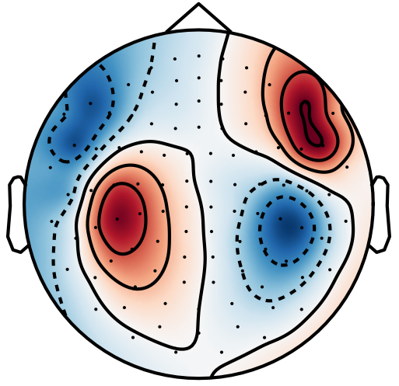

Schematic of the complexity of the problem
Bad trial
Interpolation
Bad sensor
Locally bad sensor
Sensors
Globally bad sensor
EEG: Spherical splines
MEG: MNE
[Hamalainen et al., 1994]
[Perrin et al., 1989]
Local artifacts
Trials
Proposed solution:
Lose data
if #bad-sensors > κ (=4)
drop trial
Naïve solution:
Drop bad trials and sensors
Else:
interpolate ρ (=2) worst
bad sensors per trial
Notes:
Say that you can interpolate the data from the other sensors

Slide 9
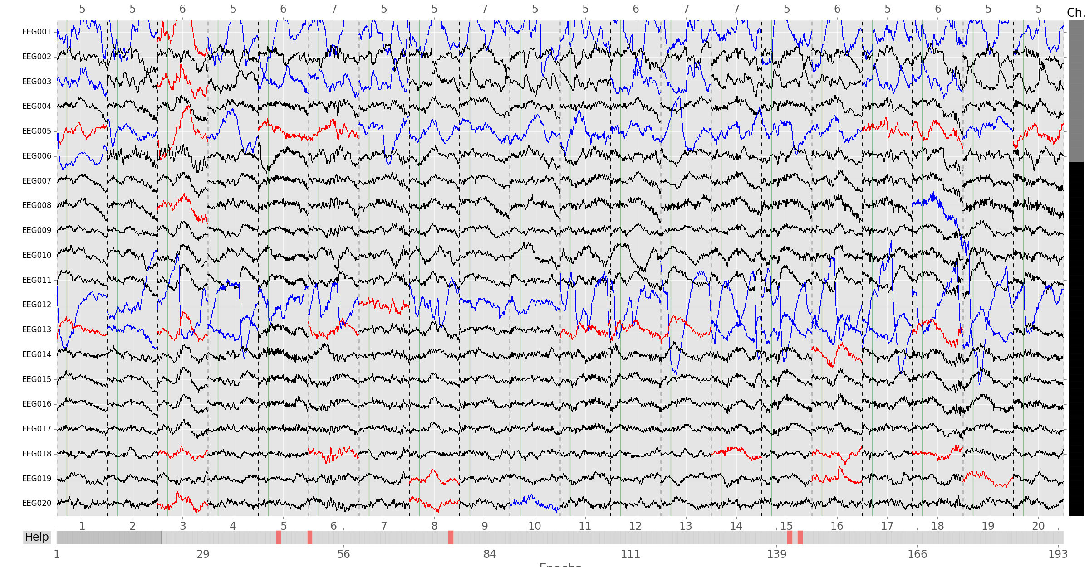
Transparency: an example diagnostic plot
Sensor to be interpolated
Bad sensor but not going to be interpolated
Bad trials
http://autoreject.github.io/auto_examples/plot_visualize_bad_epochs.html

Slide 10
Thank you

Slide 12
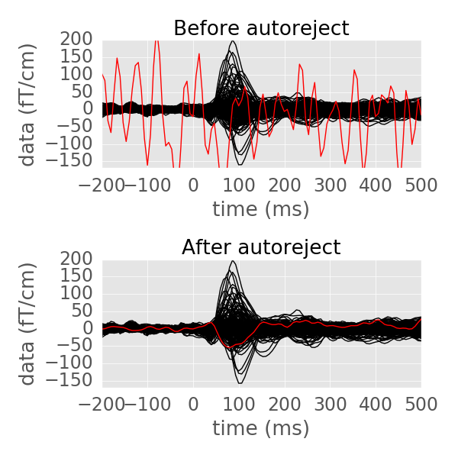
Autoreject in action: MNE sample data (MEG)
http://autoreject.github.io/auto_examples/plot_auto_repair.html

Slide 13

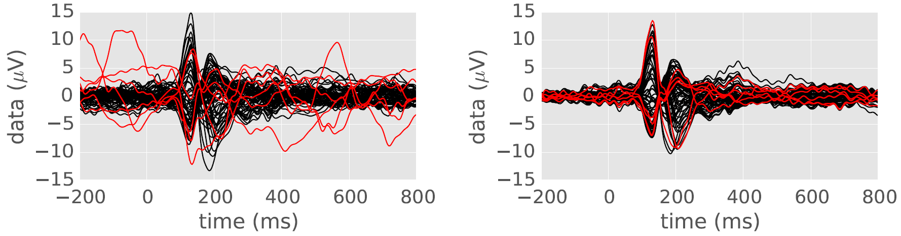
Autoreject in action (EEG data)
19 subject Faces dataset
[Wakeman and Henson, 2015]
Before autoreject
After autoreject

Slide 14
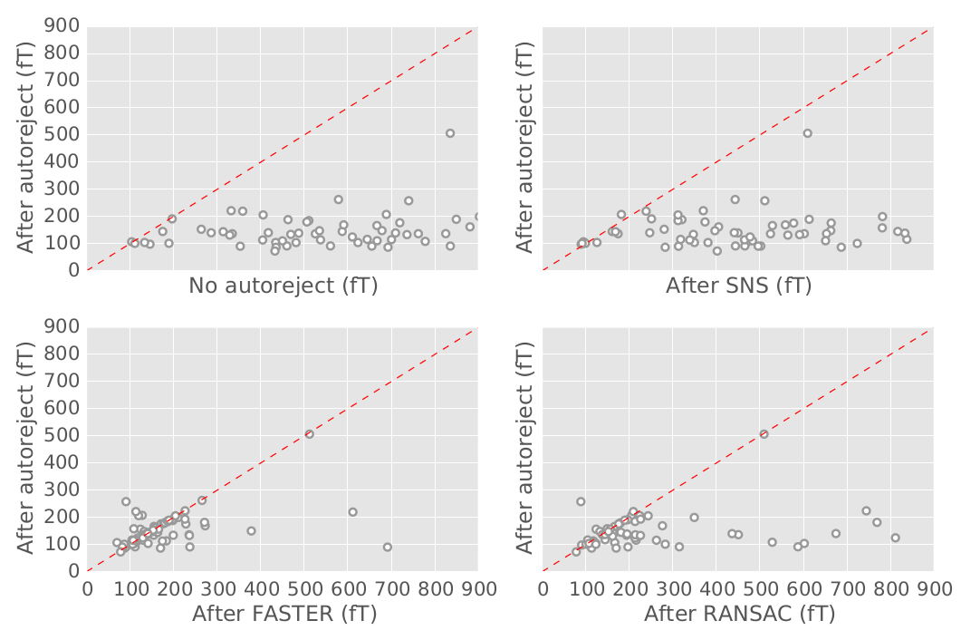

Quantitative evaluation
Competing method better
one subject
Autoreject
better
[Cheveigné, 2008]
[Nolan, 2010]
[Bigdely-Shamlo, 2015]
Notes:
Quantitative evaluation is not easy – public data, and manually curated (HCP)
What we are showing on this plot is how far we deviate from human annotated bad segments
y axis is autoreject, x axis is competing method
Each point on this plot is a single subject
Lower the deviation from human annotations, the better. Therefore, when it is below the diagonal, autoreject is better

Slide 15
How to sample the thresholds?
Grid resolution
Grid search
Random search
error
Thresholds

Slide 16
Bayesian optimization: a more efficient approach
Gaussian process
error
Thresholds
Exploration vs exploitation dilemma
Acquisition function
Notes:
Function to minimize in red
Gaussian process says which areas are unexplored

